Slide 1

CN-Mini Project
Tic-Tac-Toe Game Using Socket-Server​
This Photo by Unknown author is licensed under CC BY-SA.

Slide 2
This is a project for the class : 18CSC302J - Computer Networks by Dr. S. Thanga Revathi
(C.S.E [IT] O2)
Contributors
Sai Medha Sinha RA2011031010105
Yasar Nawaz RA2011031010115
Baladitya RA2011031010126
Aakash Raj RA2011031010128

Slide 3
Abstract
This is a simple game of tic-tac-toe developed in Python. It allows two players to play with one another on different command lines through networking. The server starts the game by first running server.py, waiting for the client to connect by then running client.py. Once their connected, the game itself starts.
The server starts as "X" and goes first, and the client is "O." The players choose the square they would like to use with coordinates; both "A1" and "1A" would be accepted, for example. The game proceeds, with the players taking turns, until one wins or the game is a draw. The host, then the client, is asked whether they'd like a rematch. If both agree, the game starts anew.

Slide 4
Objective of the project
Network Communication
We used a server/client network architecture for this project using TCP (Transmission Control Protocol), and we used port 12783. The messages were sent back and forth between the server and the client thanks to the pickle module, which converts any object (in this case, a string list storing the nine squares of a tic-tac-toe grid) into a byte stream to be sent and back into an object to be read.

Slide 5
Purpose of building Sockets
Sockets allow you to exchange information between processes on the same machine or across a network, distribute work to the most efficient machine, and they easily allow access to centralized data. Socket application program interfaces (APIs) are the network standard for TCP/IP.
Tic-Tac-Toe
Tic Tac Toe game with socket programming and VS code.
Players can compete against each other over a network by connecting to the server.

Slide 6
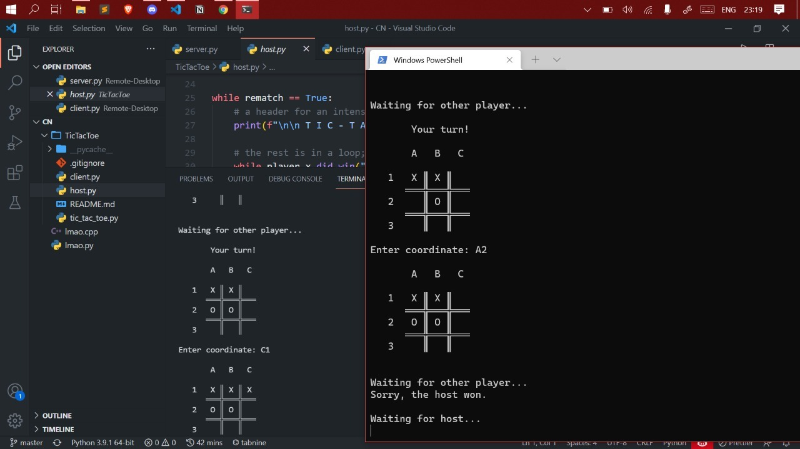
Demo

Slide 7
Development Environment
Visual Studio Code
Python (3.9.4) 64-bit
Git / GitHub
Python: Socket and Pickle modules

Slide 8
Team Members :
Sai Medha Sinha RA2011031010105
Yasar Nawaz RA2011031010115
Baladitya RA2011031010126
Aakash Raj RA2011031010128
***Thank You***

